Slide 1
Predicting On-Time Delivery in E-Commerce Using Machine Learning

Slide 2

Introduction
On-time delivery is very important for customer satisfaction in e-commerce. As international shipments increase, delivery delays have become more common. This project uses machine learning to analyze e-commerce delivery data and predict whether an order will arrive on time or late. By studying shipment and logistics details, the project identifies key factors that affect delivery performance and helps businesses make better logistics decisions.

Slide 3

Problem Statement
Ensuring on-time delivery is a major challenge in international e-commerce due to complex logistics. This project uses machine learning to predict whether an order will be delivered on time or late.
Key Objectives:
• Identify the main factors causing delivery delays
• Help businesses improve logistics planning and decisions

Slide 4

Project Objectives
Predict on-time vs late delivery using machine learning models
Identify key factors influencing delivery delays to support data-driven decisions

Slide 5
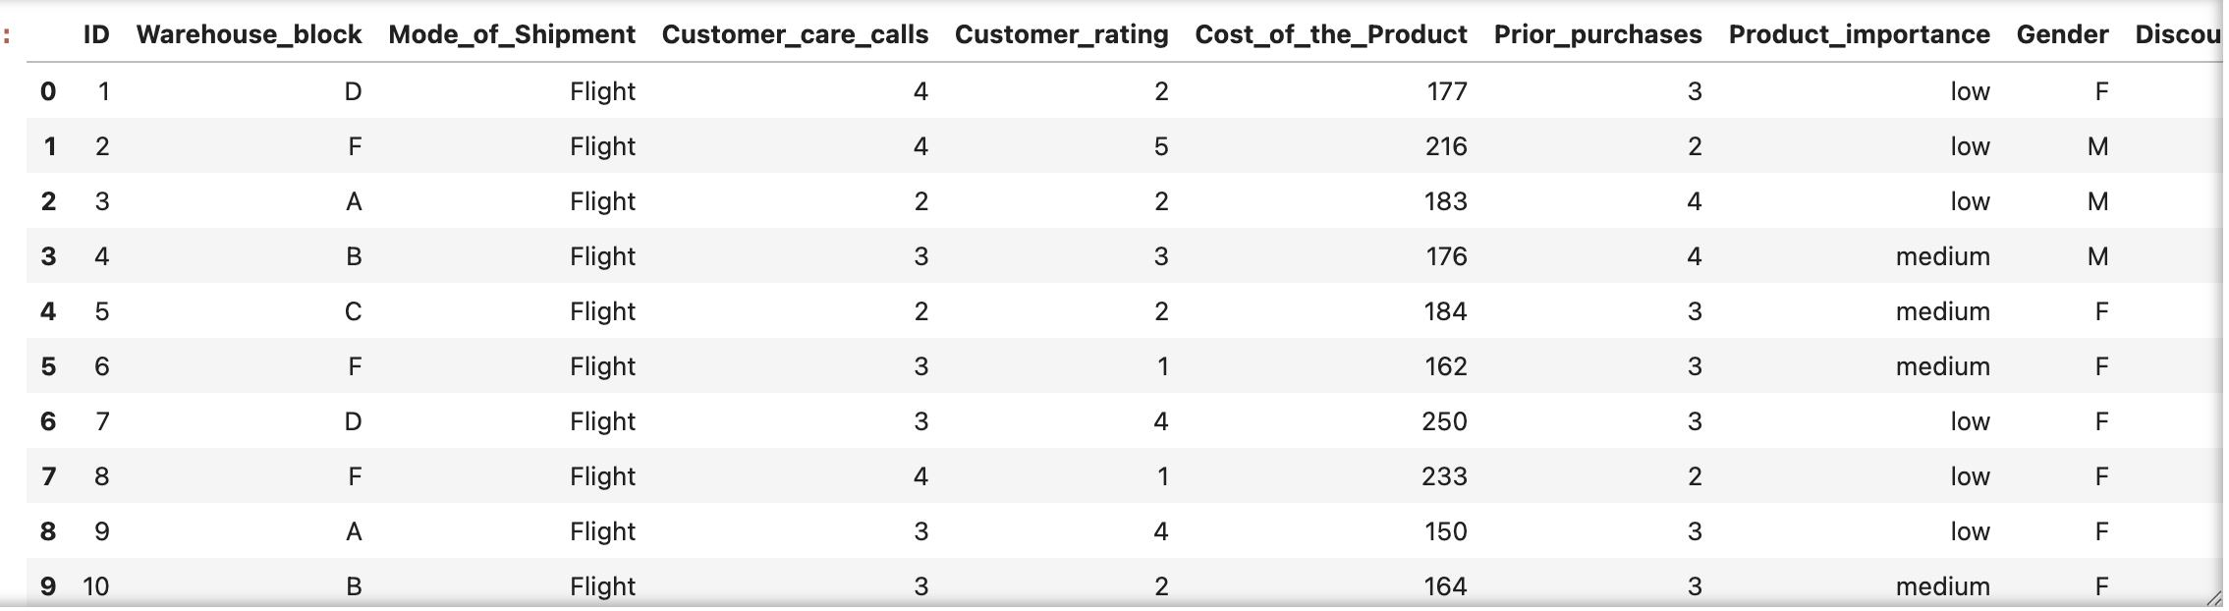
Dataset Overview
E-commerce delivery dataset with order details
Includes customer, product, and shipment features
Delivery status (on-time / late) is the target variable

Slide 6
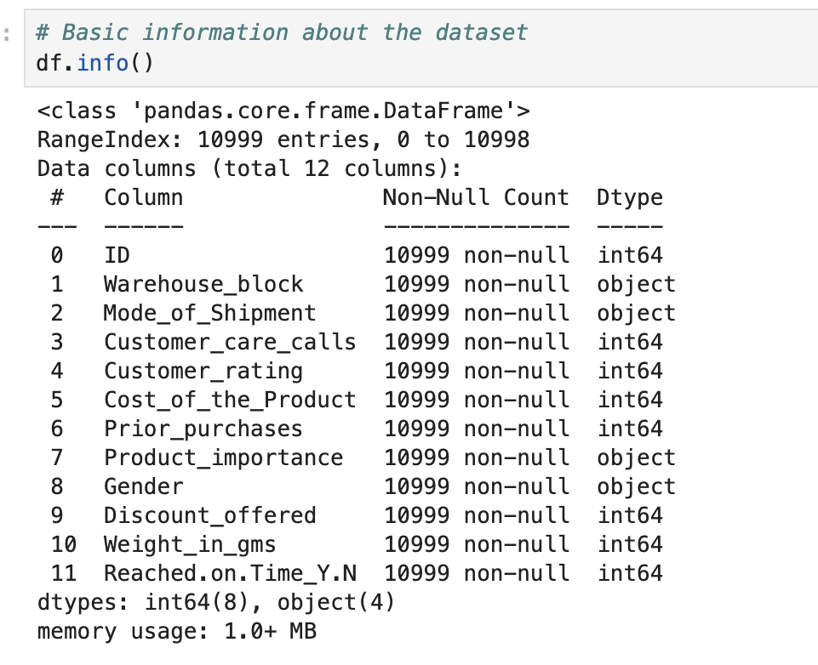
Data
Understanding
Analyzed dataset structure
Identified key feature columns
Defined target variable

Slide 7
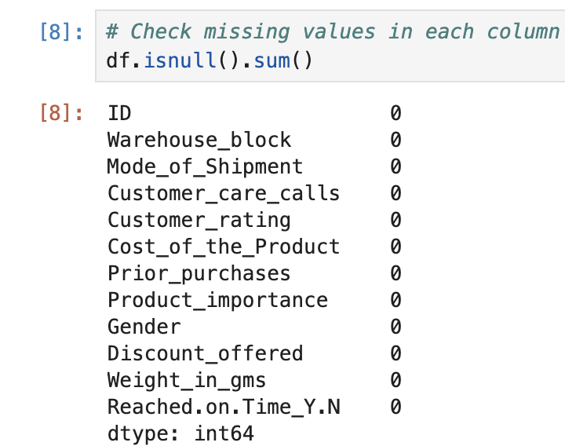
Data Cleaning
Checked missing values
Verified duplicate records
Prepared dataset for modeling

Slide 8
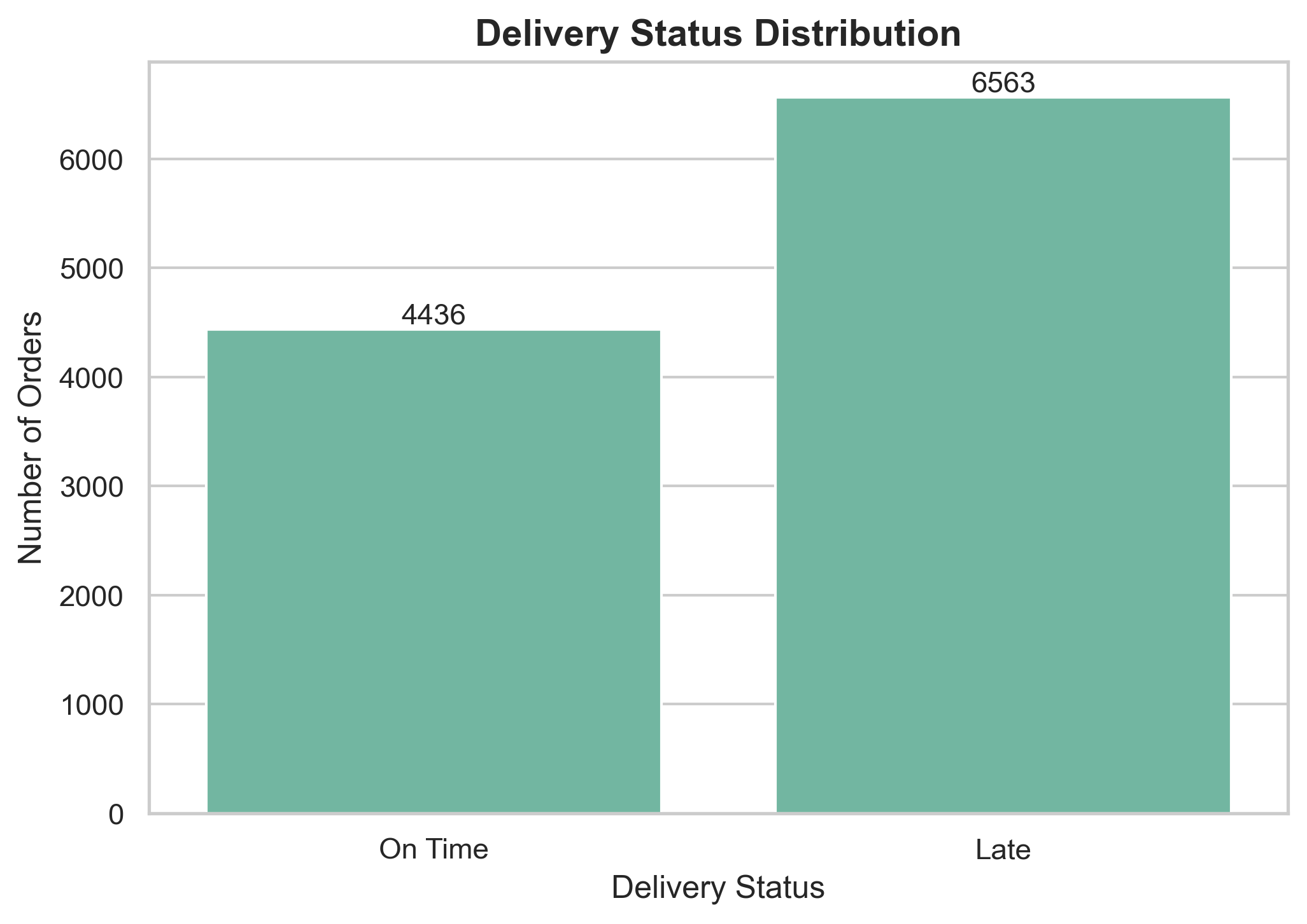
Exploratory Data Analysis (Univariate)
Analyzed delivery status distribution
Compared on-time vs late orders
Identified delivery imbalance

Slide 9
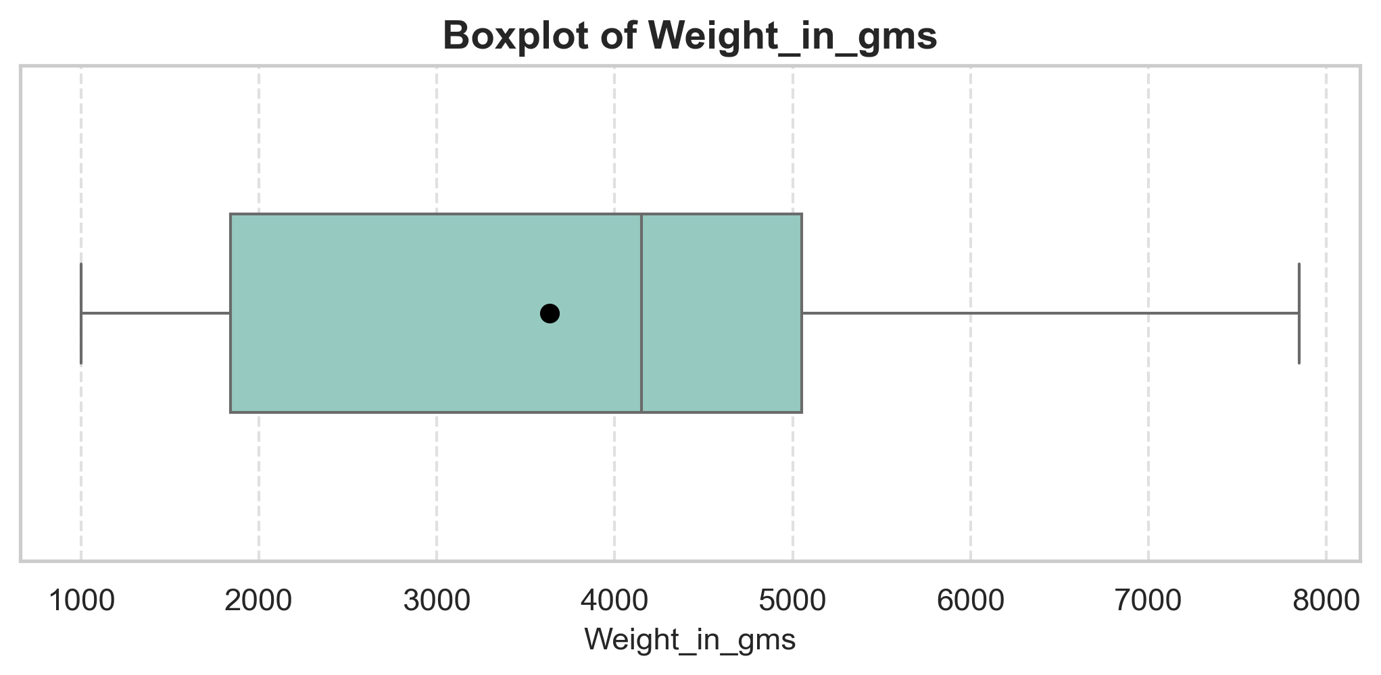
Exploratory Data Analysis (Univariate)​
Package weights range from 1,000 to 8,000 grams
Average (median) weight is around 4,200 grams
Most packages weigh between 2,000 and 5,000 grams
Weight distribution is slightly right-skewed
No major outliers observed

Slide 10
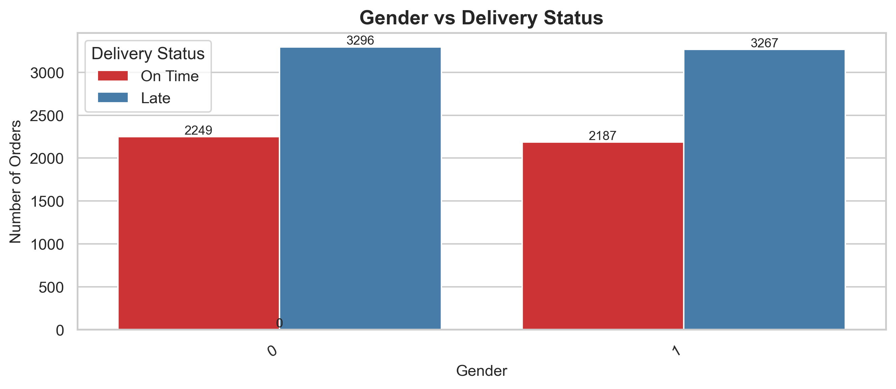
Exploratory Data Analysis (Bivariate)
Late deliveries are more common than on-time deliveries
• Both genders have similar delivery patterns
• On-time and late counts are nearly equal across genders
• Gender does not affect delivery timeliness

Slide 11
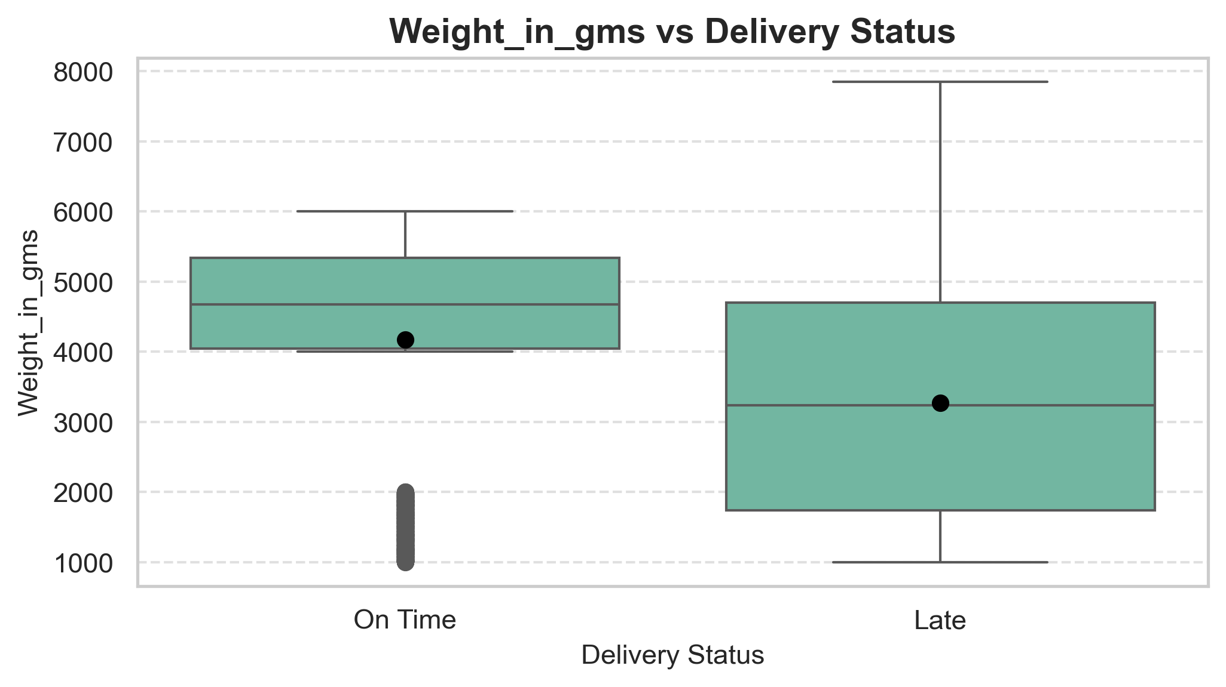
Exploratory Data Analysis (Bivariate)
On-time deliveries have higher average weights
Late deliveries have lower median weight
Late deliveries show a wider weight range
On-time deliveries are more consistent in weight
Weight may influence delivery status

Slide 12
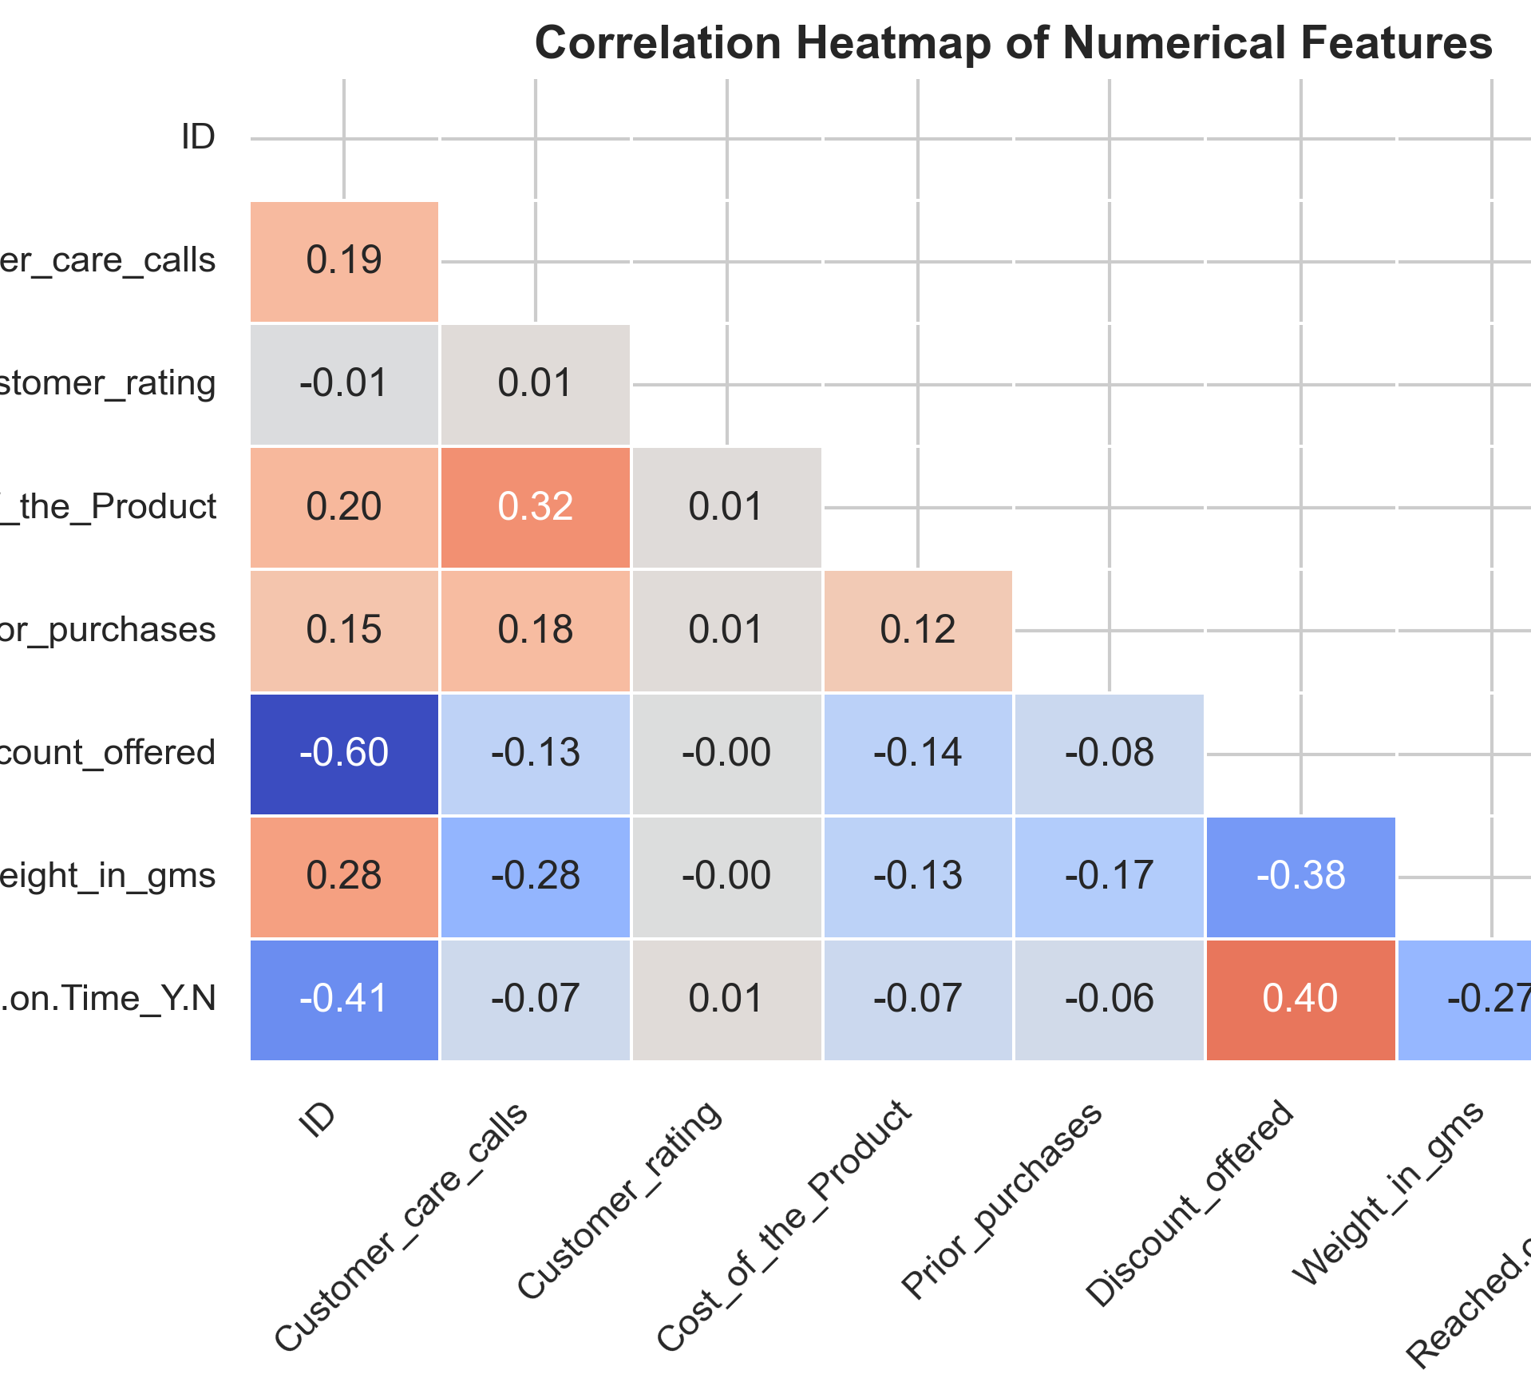
Correlation
(Heatmap)
Shows relationships between numerical features
Discount offered is positively related to on-time delivery
Package weight is negatively related to on-time delivery
Customer care calls show a weak negative relationship
Most features have low correlation, no strong single predictor

Slide 13
Model Selection
Random Forest achieved one of the highest accuracy scores among all models
It shows very high precision, meaning most predicted late deliveries are correct
The model performs well in handling complex relationships between features
Random Forest is less prone to overfitting compared to a single decision tree
Overall, it provides a strong and reliable balance for predicting delivery status

Slide 14

Evaluation metrics
Evaluation Metrics
Accuracy: Measures overall correctness of the model’s predictions
Precision: Indicates how many predicted late deliveries were actually late
Recall: Measures how well the model identifies all late deliveries
F1 Score: Balances precision and recall into a single performance measure
Multiple metrics are used to get a complete and fair evaluation of each model

Slide 15
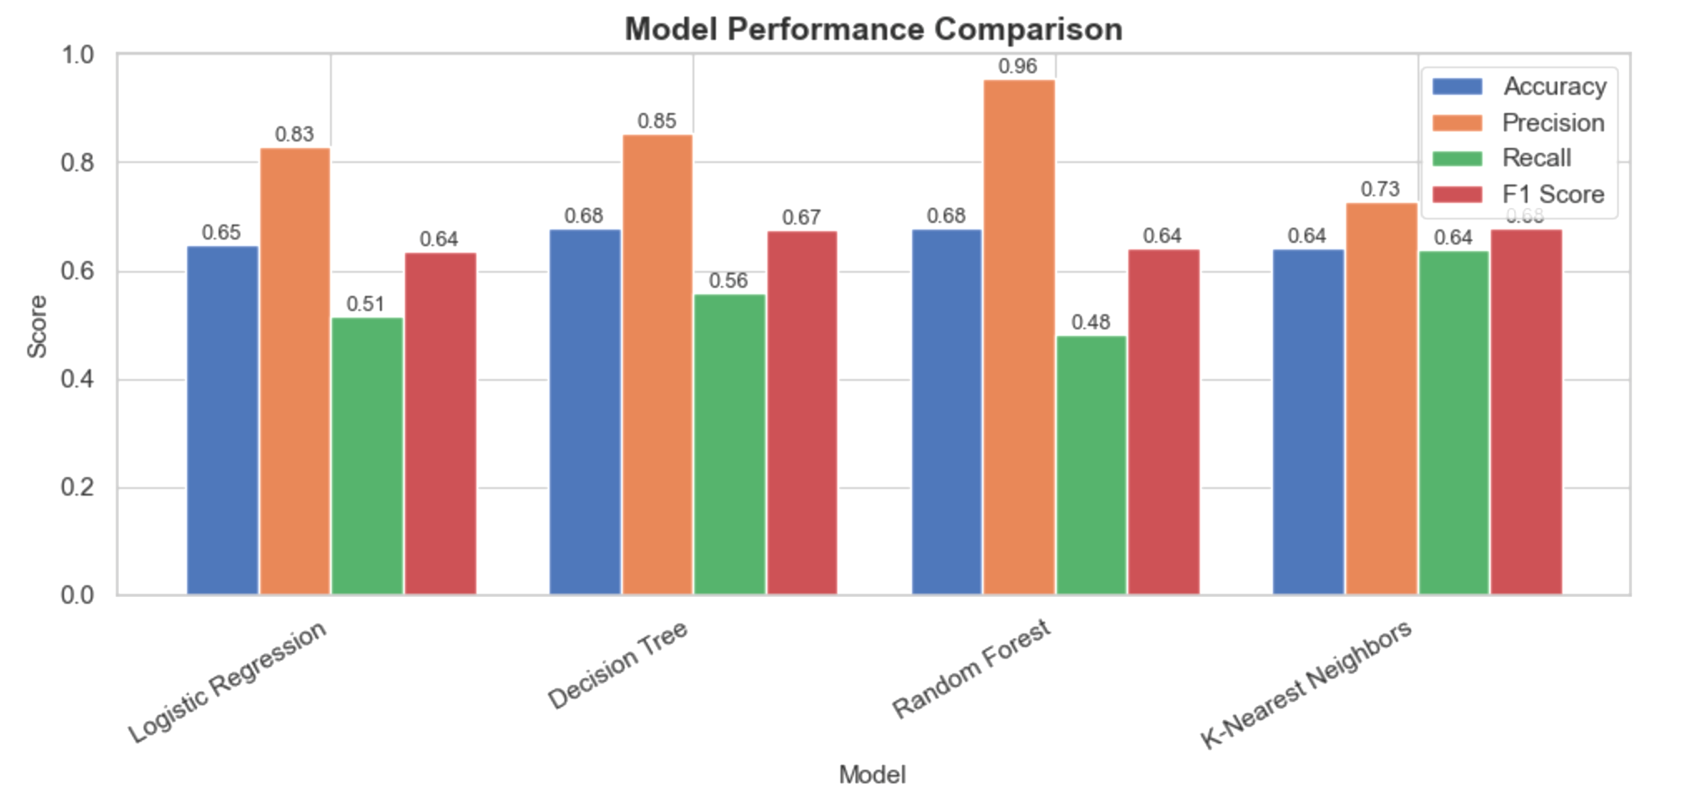
Model Comparison
Four machine learning models were evaluated using Accuracy, Precision, Recall, and F1-score
Random Forest shows the highest accuracy and precision, making it the most reliable model
Decision Tree performs well with balanced accuracy and F1-score
K-Nearest Neighbors has good recall but slightly lower accuracy
Logistic Regression provides a baseline but performs lower than other models
Overall, Random Forest performs best and is selected as the final model

Slide 16
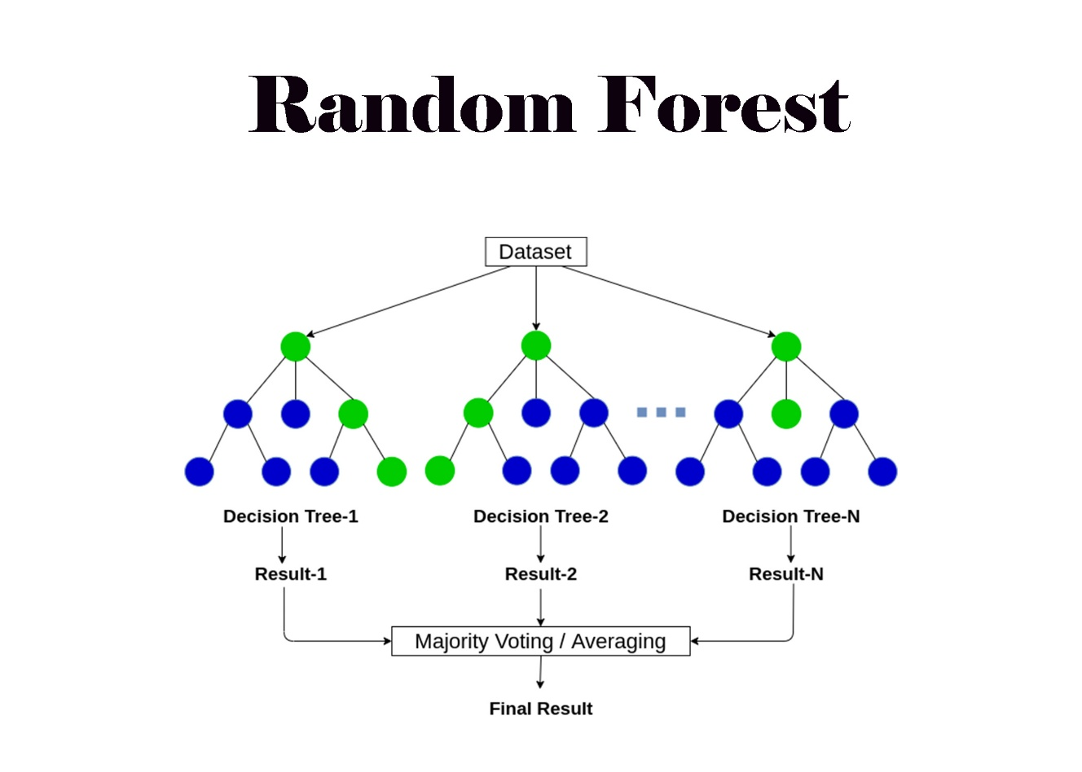
Best Model
Best performing model: Random Forest
Achieved highest accuracy among all models
Robust model that handles complex patterns well

Slide 17

This project successfully applied machine learning techniques to predict on-time vs late deliveries in e-commerce.
Through data analysis, key factors such as product weight, discounts, shipment mode, and warehouse block were identified as influential in delivery performance.
Multiple models were evaluated using accuracy, precision, recall, and F1-score, and Random Forest was selected as the best-performing model.
The results demonstrate how predictive analytics can support better logistics planning and business decision-making.
Overall, the project highlights the value of data-driven approaches in improving delivery reliability and customer satisfaction.

Slide 18
Thank You!

